Slide 1

UniLaunchres Concept
By: Dominic Nguyen
Web Developer
Fullsail University

Slide 2
Motivation For making Site
I wanted a quick and easy way to access your games cluttered in other launchers to have one convenient simple way to add and play games with a click of a button

Slide 3
Functionality
Being able to add a game into the library which will then be able to be launched from your computer using either the phone site or desktop site.

Slide 4
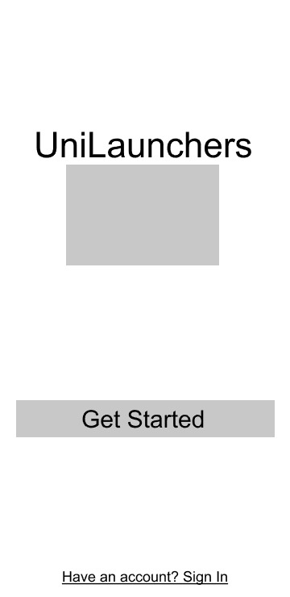
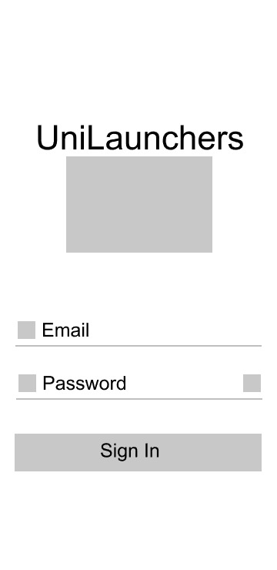

Mobile Version
B
A: Logo
B: Drop down Menu
C: Icons that I’m still thinking About
D: First time text that lets you know you should add something.
A
A
A
C

Slide 5
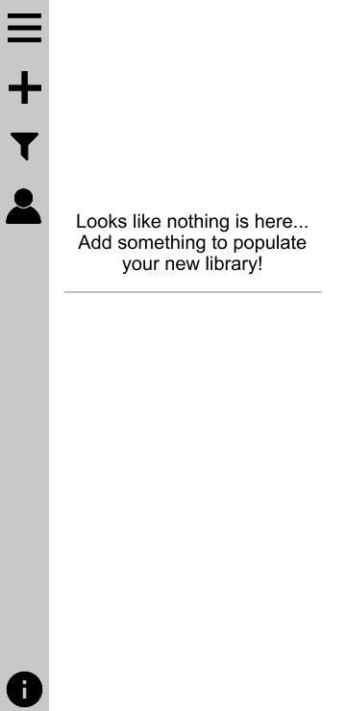
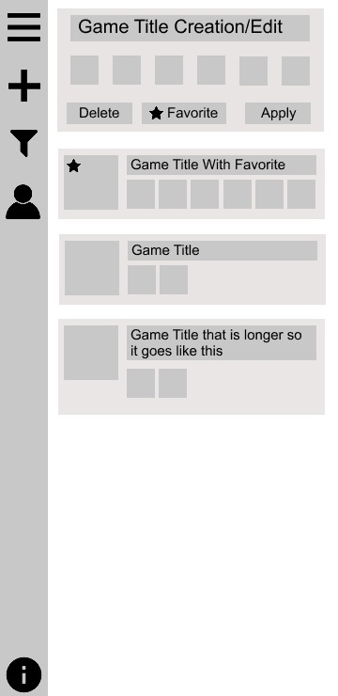
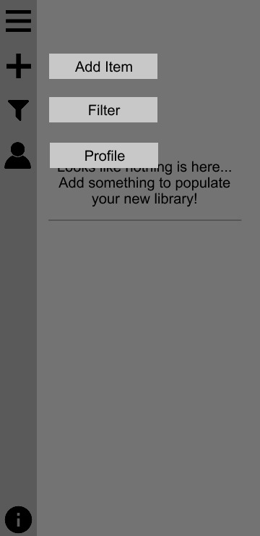
Mobile Version
C
A
C2
A: Icons for tasks for mobile site
B: Information button: Tells you what each Icon does
C: Add Item form populates field.
Each Square Represents a checkbox that has image of game launcher icon.
Form has multi use, first time creating and when editing.
C2: Clicking Game Icon opens up edit Menu, might make event when it’s a double click.
C

Slide 6
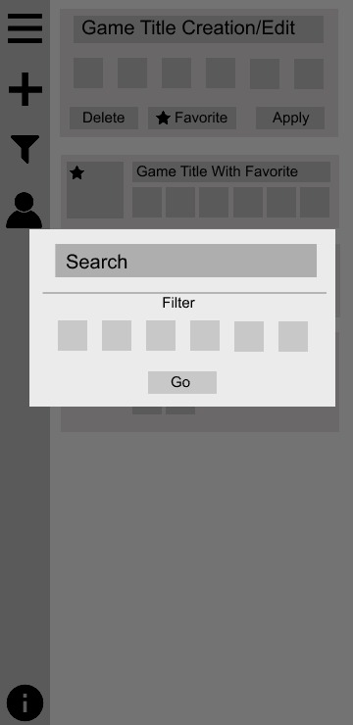
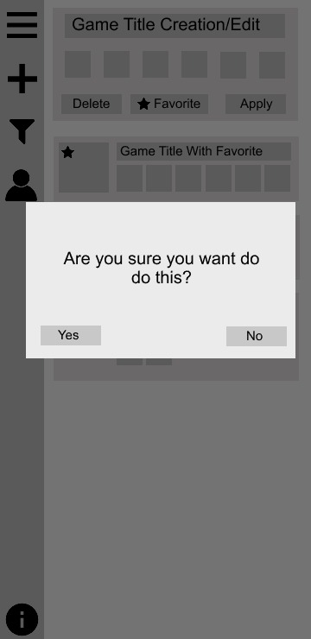
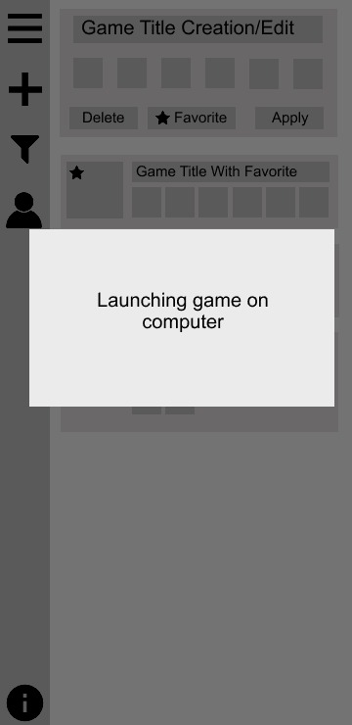
Mobile Version
A: Filter Popup, Boxes represent checkboxes like creating item to filter what games you want to be filtered.
B: Simple confirmation window, appears with menu either hidden or shown.
C: Letting user know when clicking game to start that it will launch on desktop.
A
B
C

Slide 7
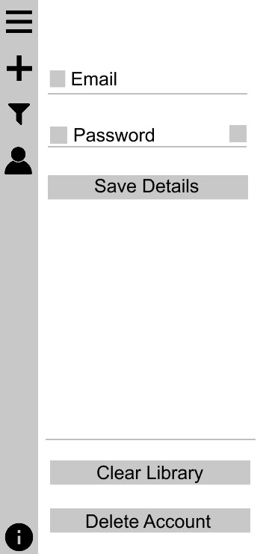
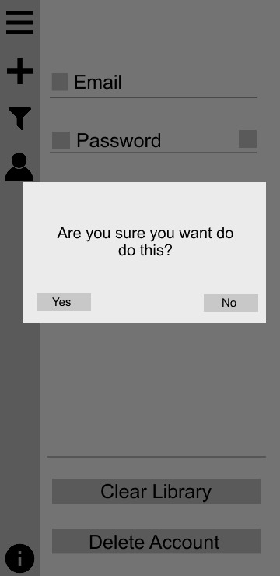
Mobile Version
A
A: Quick easy Email or password changer. Icons up for debate
B: Buttons on bottom give user way to either remove account or clear whole library.
C: Confirmation window for each button so you don’t accidently nuke your whole library
C
B

Slide 8
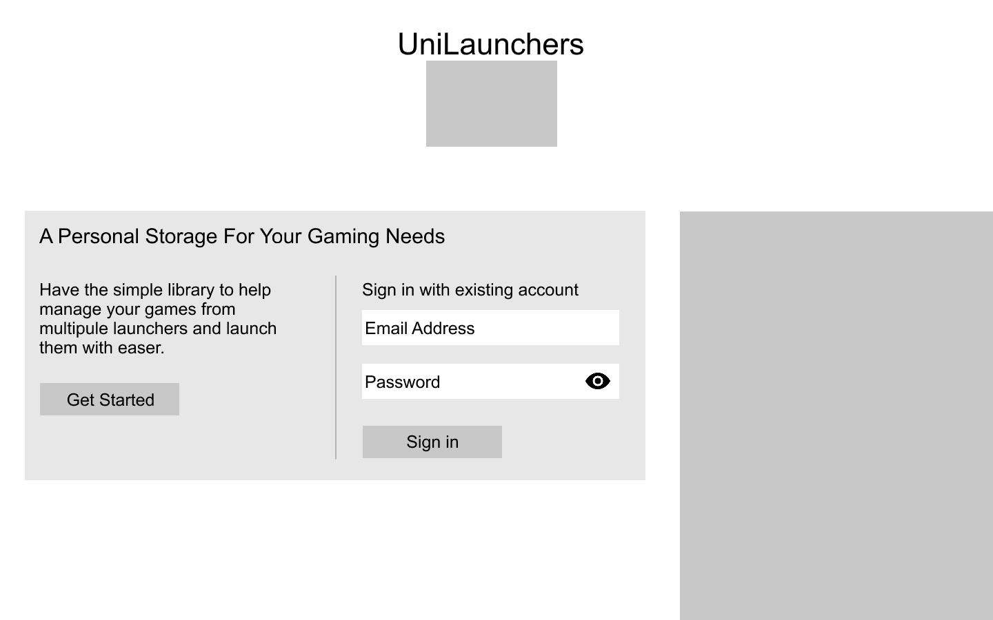
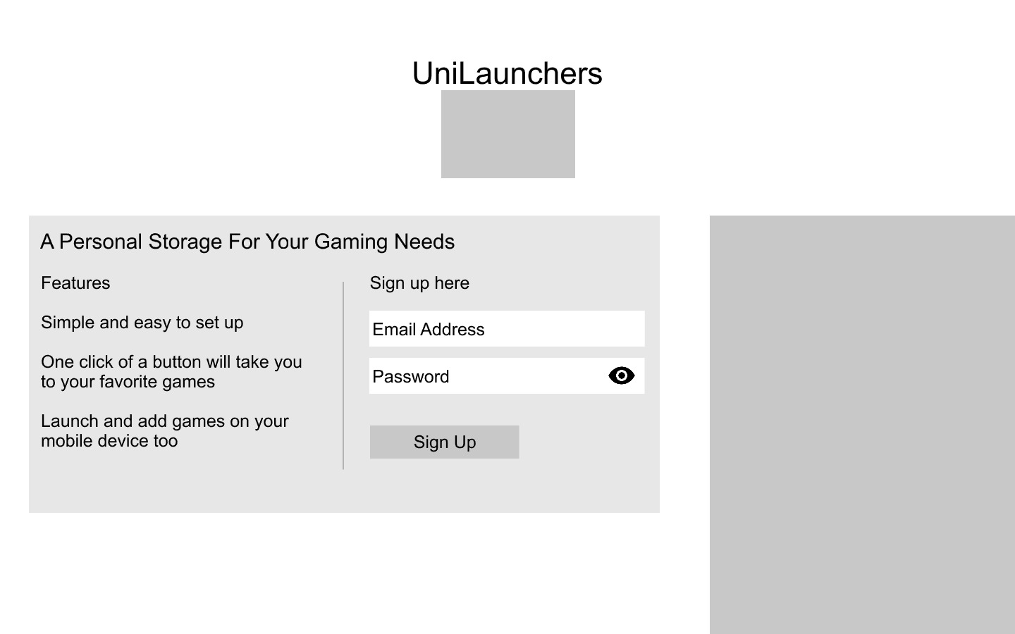
Desktop Version
A
C
A: Brand Icon
B: Design Image to mix with simple background, particles effect with invis img background
C: Using a design idea I checked online to get rid of typing password twice with an icon that reveals password
B
A
B
C

Slide 9
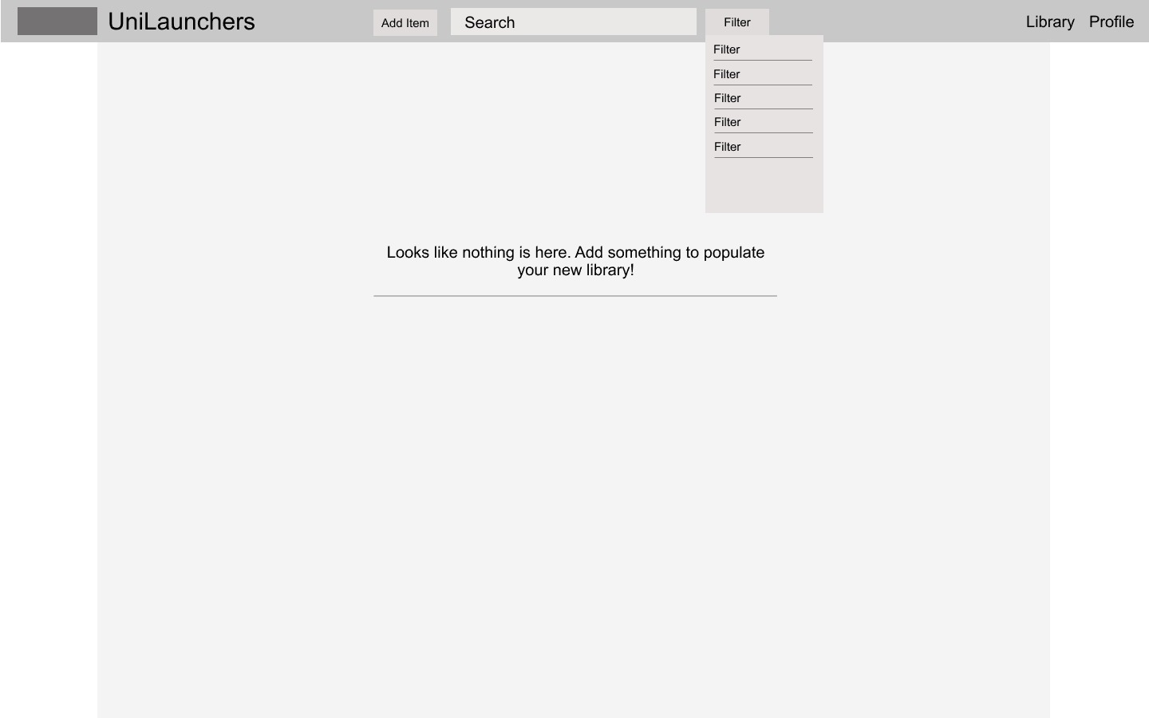
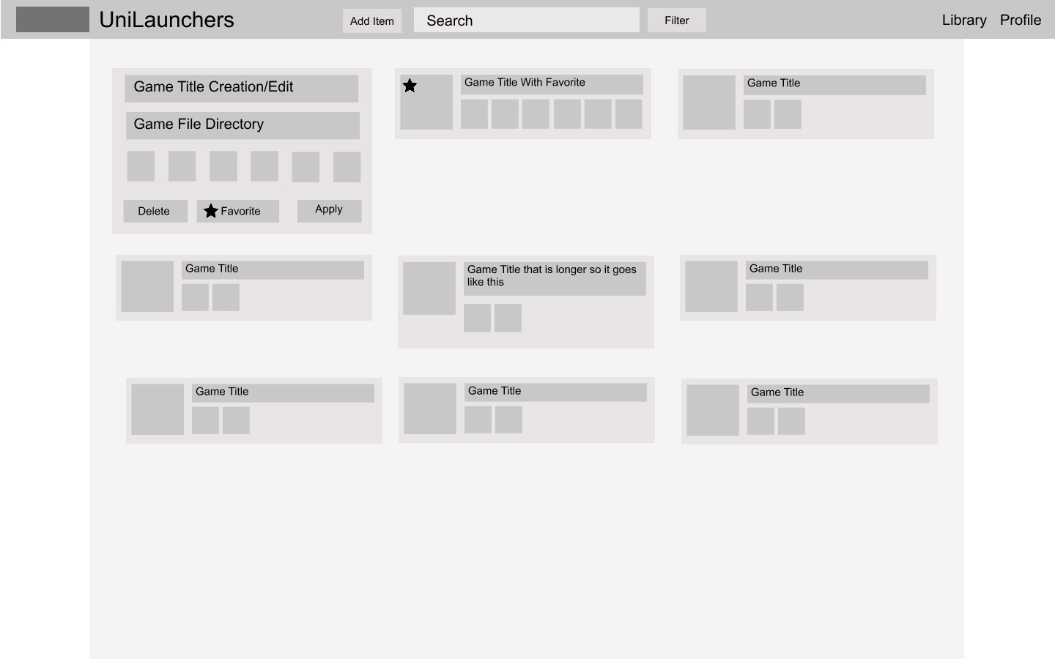
Desktop Version
A
B
C
D
A: Logo. Escape hatch
B: Item creation/filter area
C: Nav Area
D: First time/empty
A

Slide 10
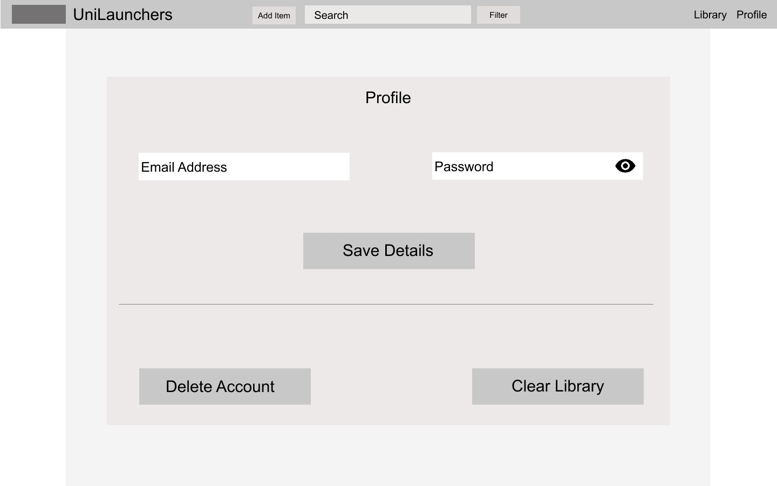
Desktop Version
A
B
A: Profile edit details
B: Profile/library settings

Slide 11
Audience
Fitted towards a gamer that wants more organization.
A casual audience might not care for organizing their launchers will have to look more into that.
People who know what game they play and won’t care for extra aesthetics like a description/rating.

Slide 12
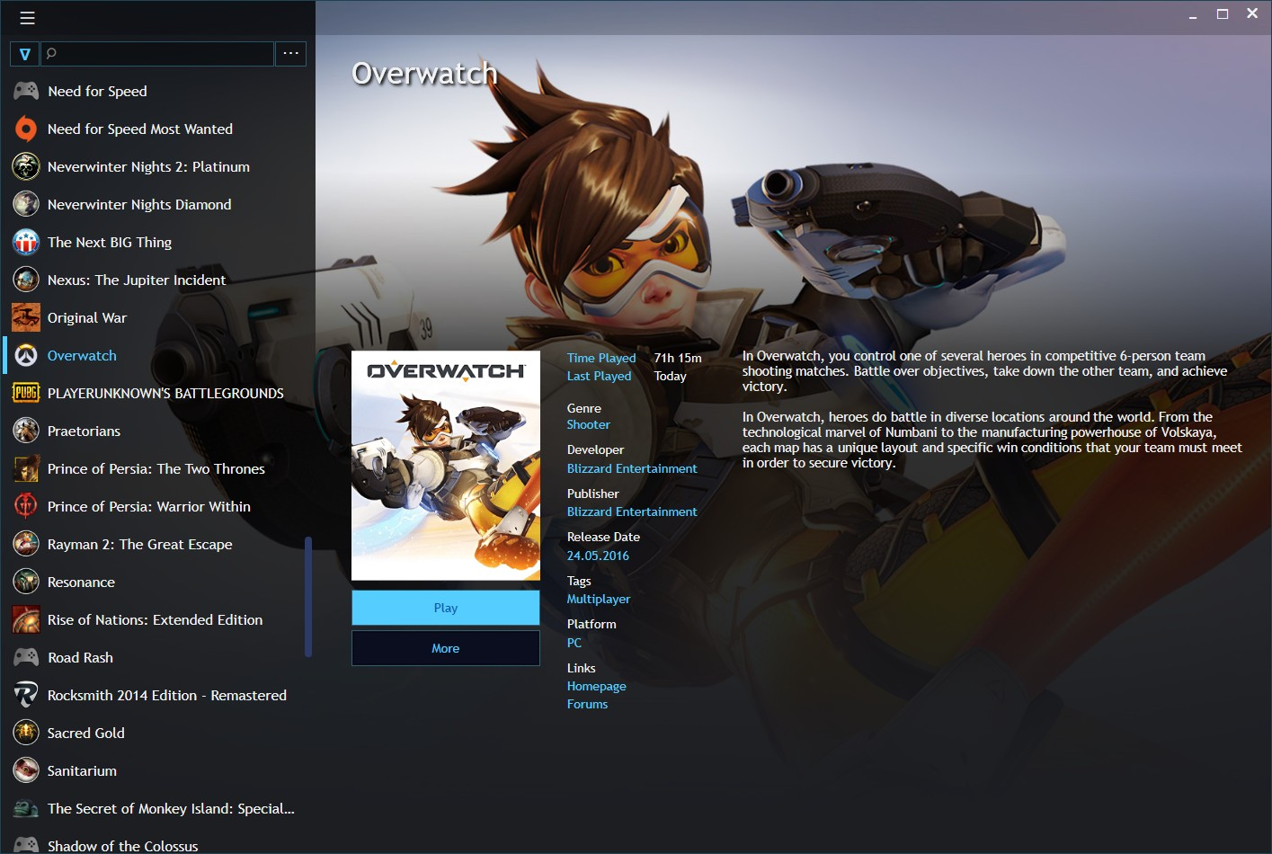
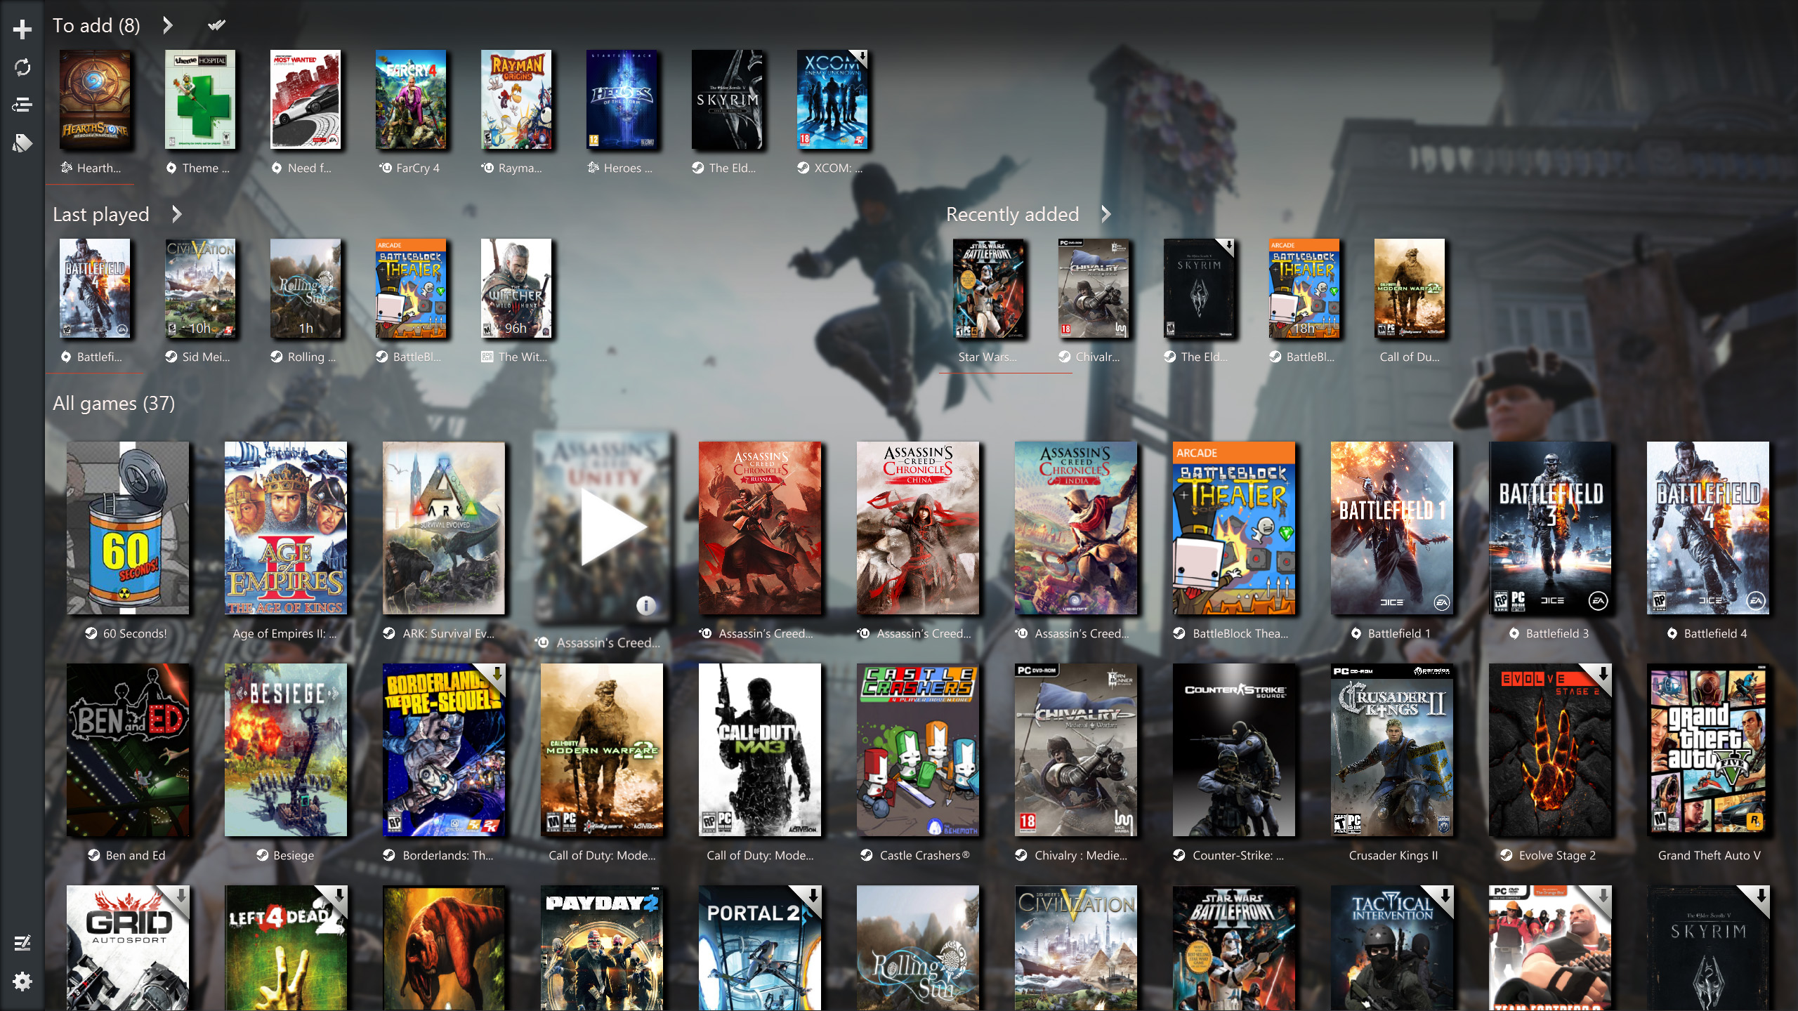
Competitors
Playnite
Game Room

Slide 13
Why My Idea Will Be Different
I feel other game launcher managers are trying to be too much like steam and end up cluttering their manager with fluff that would be too much of a hassle since the other launchers already do that.
Wanted to have a mindset of something similar to a music library where the content is simple and very easy to access.

Slide 14
Estimate Costs
While checking online the domain, UniLaunchers.com was taken so I was going to use the .net version.
Yearly Cost was 12$ though if I wanted to be more creative I could find a more interesting SLD.

